Slide 1
Control of double inverted pendulum
Reinier de Bruin & Cas Hofman

Slide 2
Content
Introduction
Theory
Results & Discussion
Conclusion

Slide 4
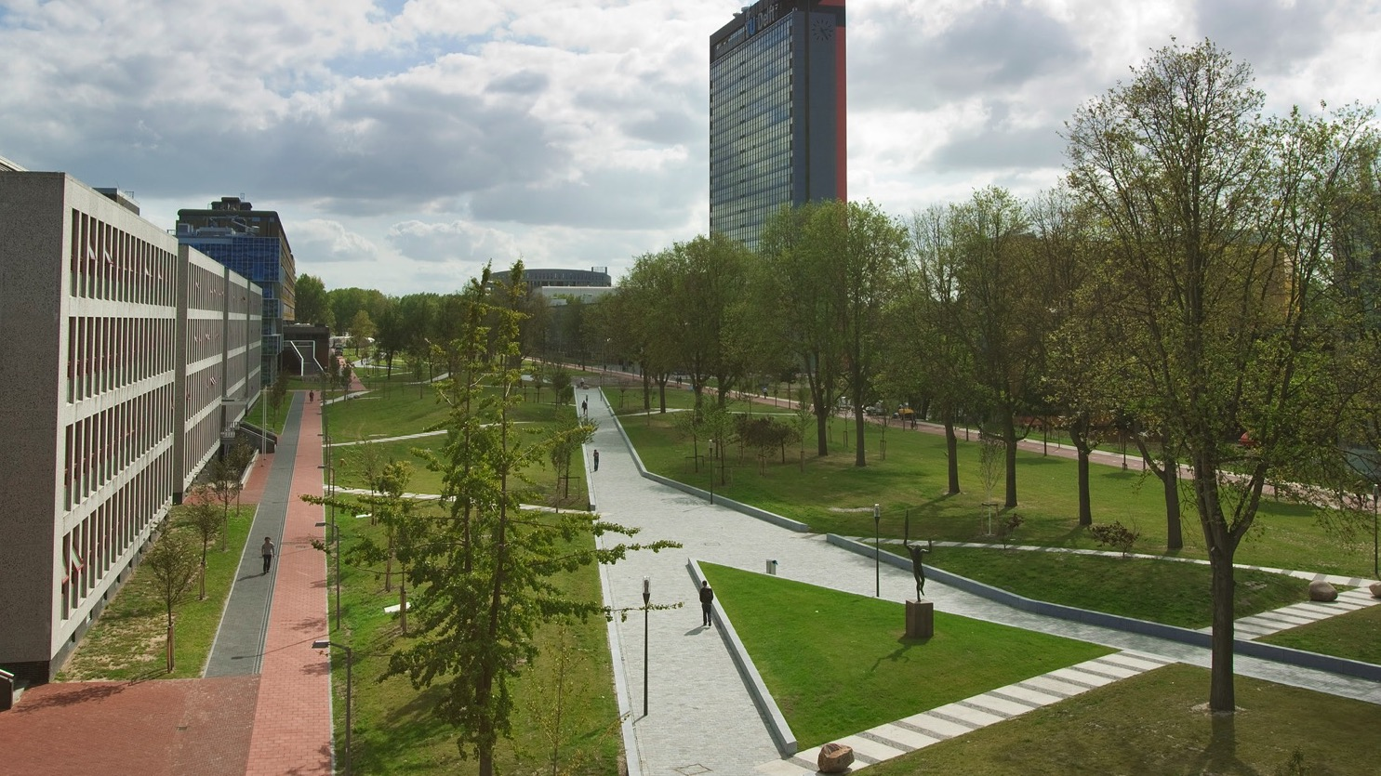
Insert a picture

Slide 5

Insert a picture

